Slide 1
DISCHEM RIDE FOR SIGHT
13 FEBUARY 2011
WATERING HOLE 3
( OF COURSE THE WINNING HOLE OF THE DAY )

Slide 2
4 STEPS TO WINNING
PROMOTE A AWESOME BRAND
EMPLOYE THE BEST AMBASSODORS
TAKE OVER THE ROAD
GIVE A 1000% FROM 04:00 TO 15:00
PASSION AND ENTHUSIASM COMES STANDARD

Slide 3
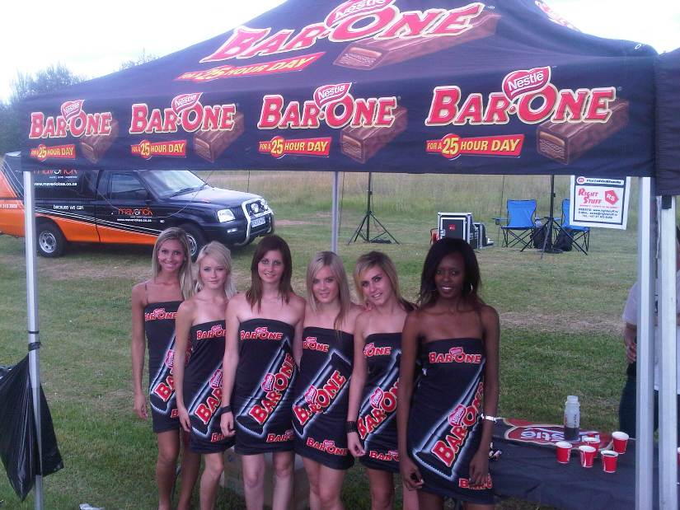

Slide 4
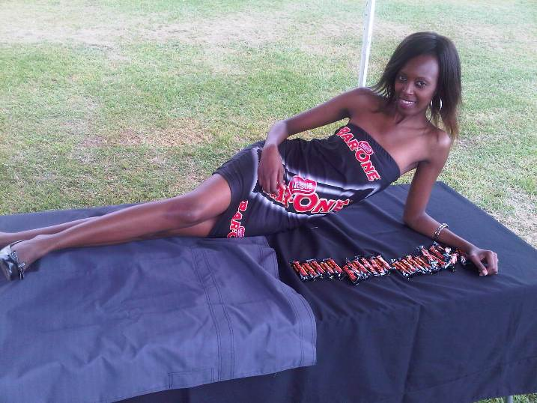
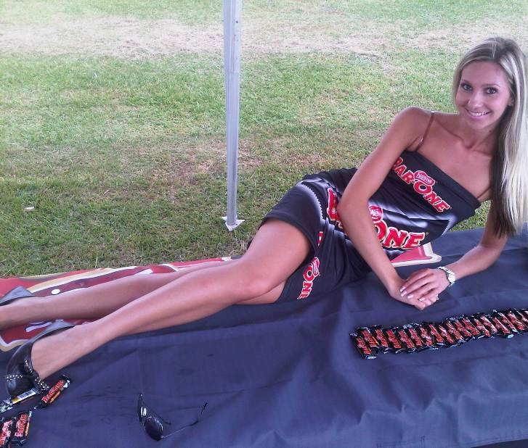
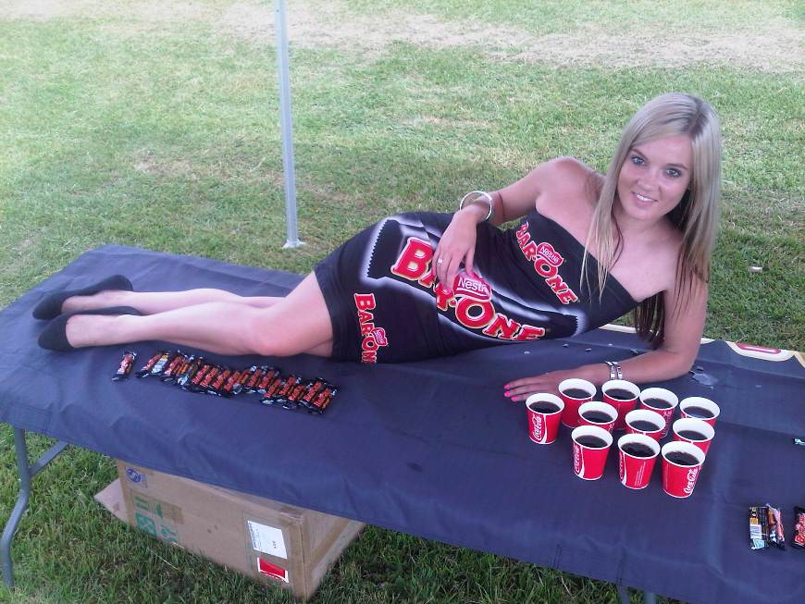

Slide 5
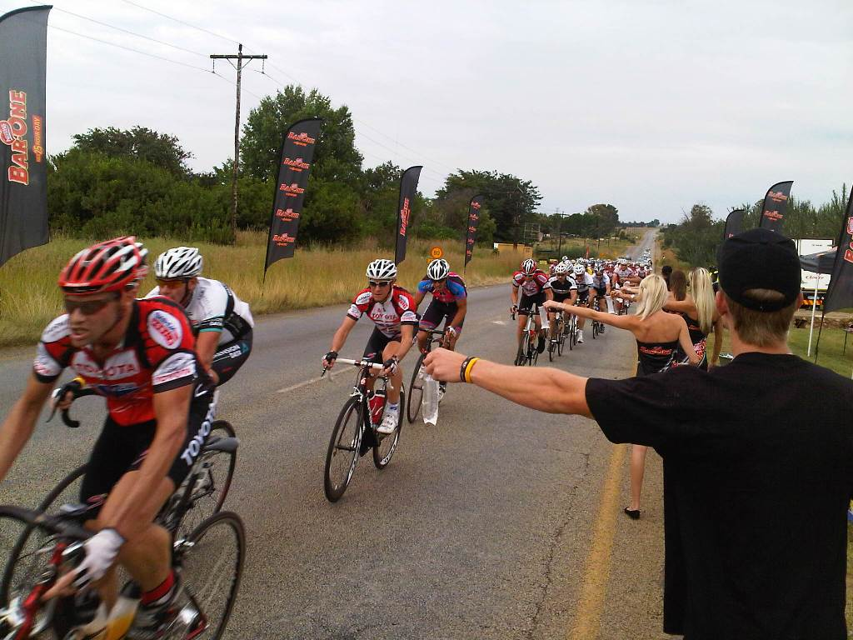
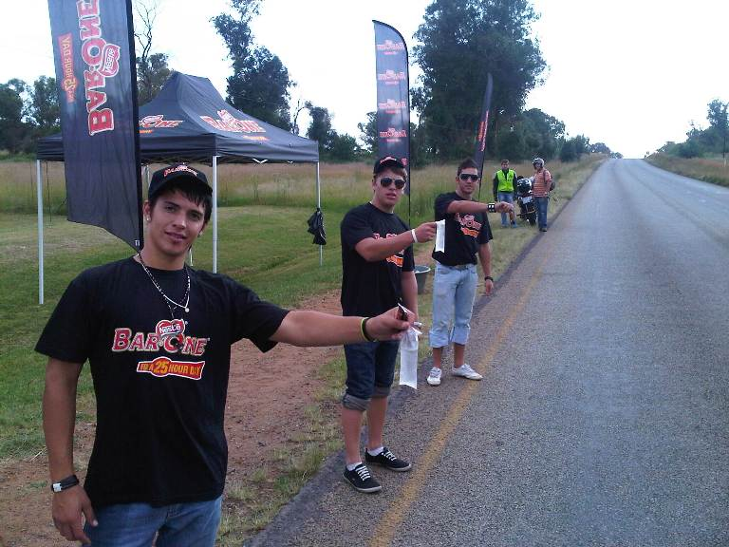
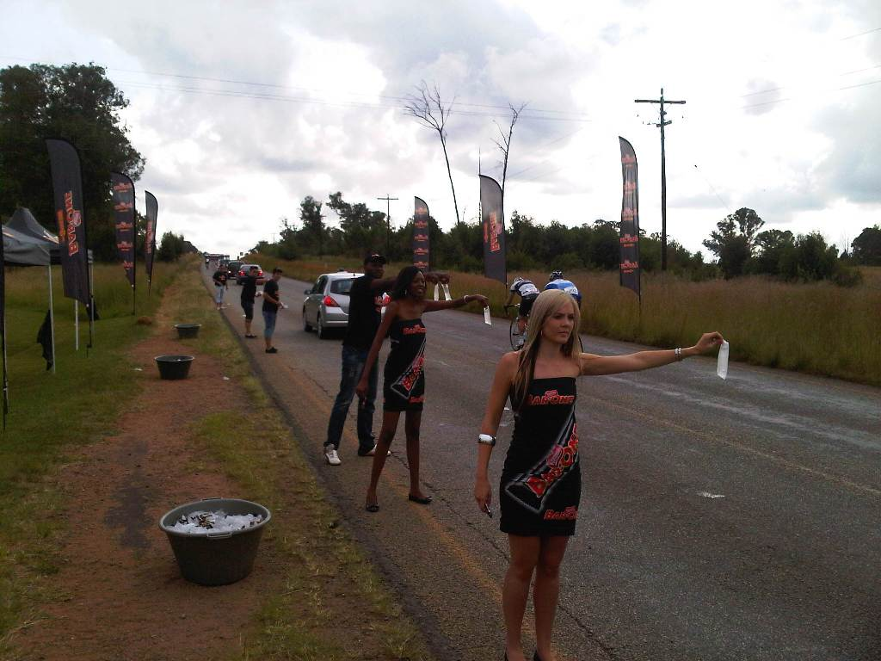

Slide 6
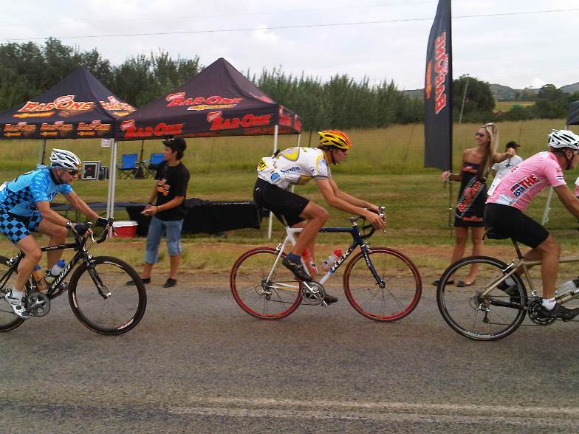
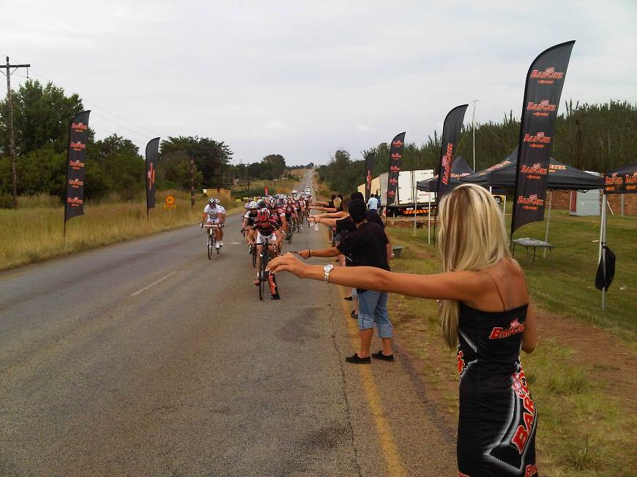
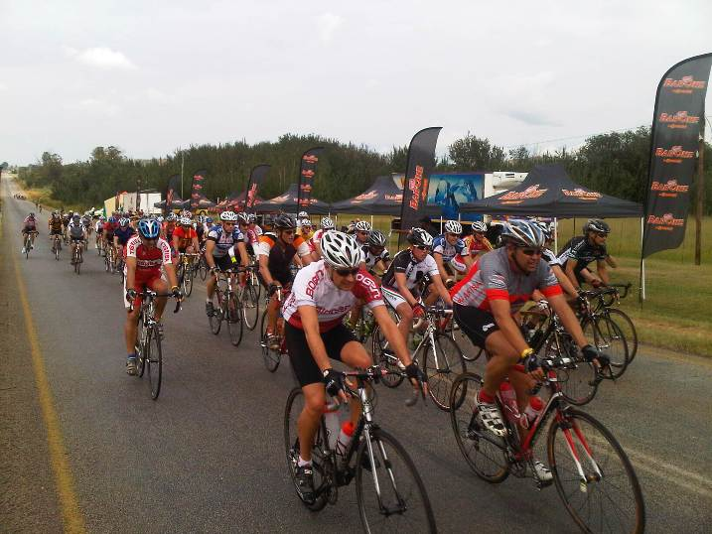

Slide 7
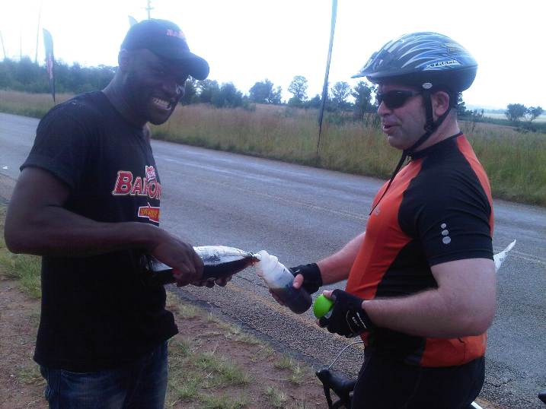
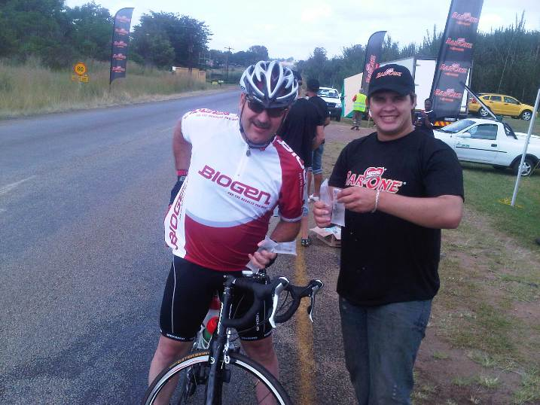
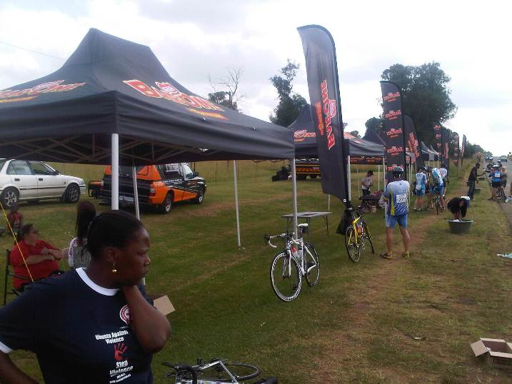

Slide 8
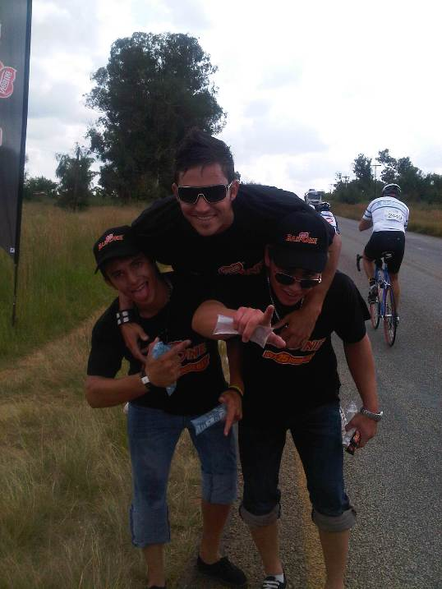
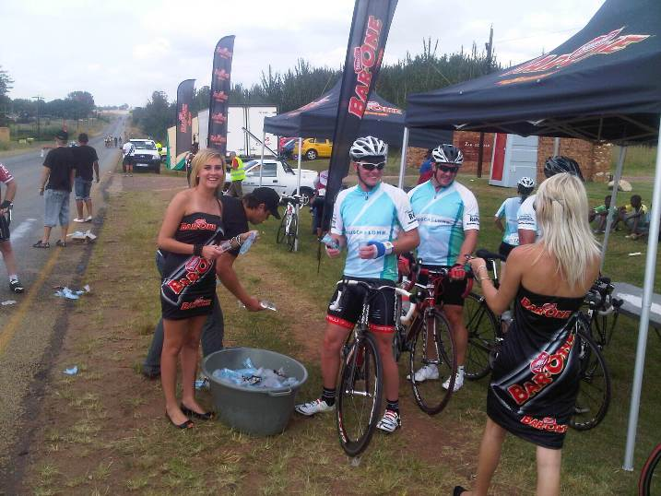
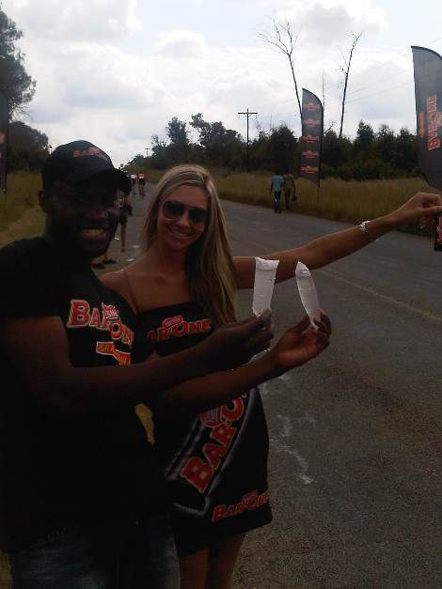

Slide 9
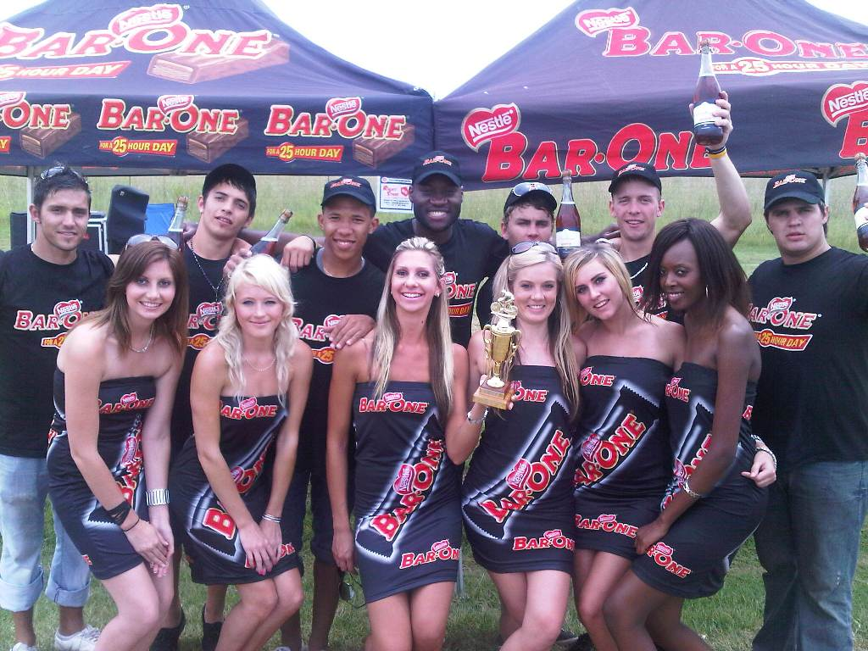
WINNERS

Slide 10
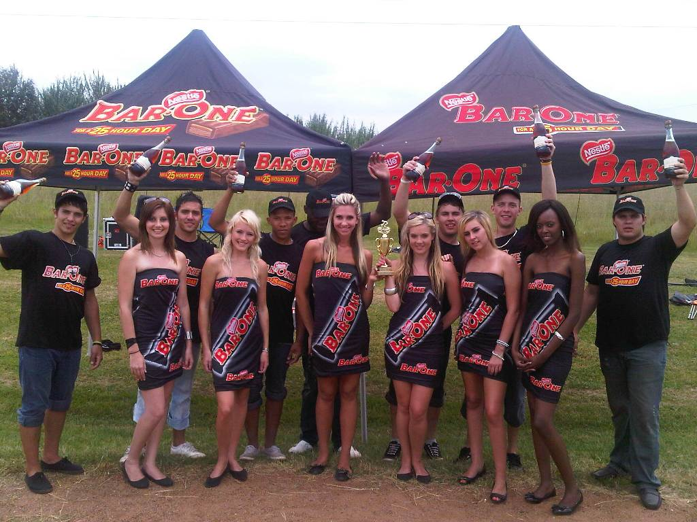
WINNERS

Slide 11
VANELLI PROMOTIONAL MODELLING
VANELLI – VANELLI – VANELLI-
VANELLI-VANELLI-VANELLI-VANELLI
VANELLI-VANELLI
VANELLI-VANELLI-VANELLI
SOPHISTICATION-PROFFESLISLIAM
VANELLI
PROMOTIONAL MODELLING

